Slide 1
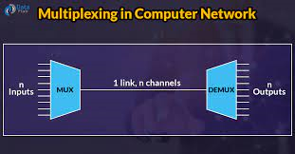
Lec -14
Multiplexing

Slide 2
What is multiplexing ?
Multiplexing is a type of technique that is used to combine and send the multiple data streams over a single medium. The process of combining the data streams is known as multiplexing .
Or
Multiplexing means sharing of a medium or bandwidth. It is the process in which multiple signals coming from multiple sources are combined and transmitted over a single communication/physical line.
Or
Multiplexing is the set of techniques that allows the (simultaneous) transmission of multiple signals across a single data link.

Slide 3
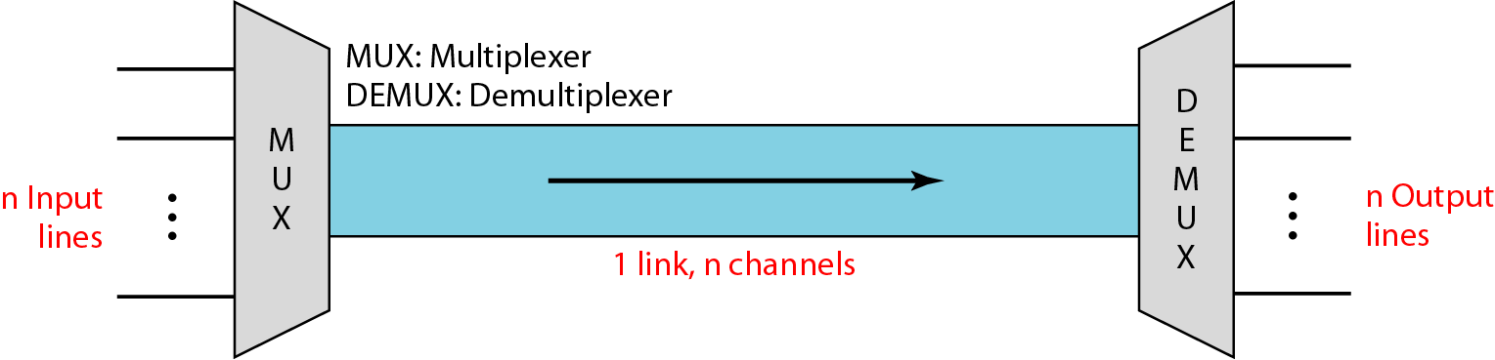
Diagram of Multiplexing .

Slide 4
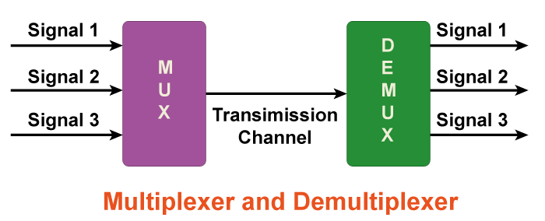
Difference between Multiplexer and De- multiplexer .
A multiplexer (Mux) is a combinational circuit that uses several data inputs to generate a single output.
A demultiplexer (De-mux) is also a combinational circuit that uses single input that can be directed throughout several outputs.

Slide 5
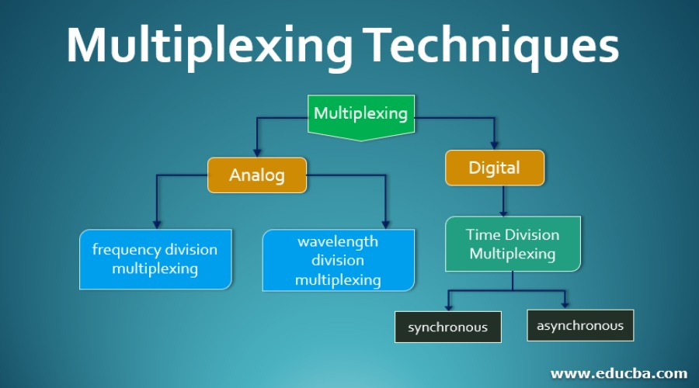
What are types Multiplexing ?

Slide 6
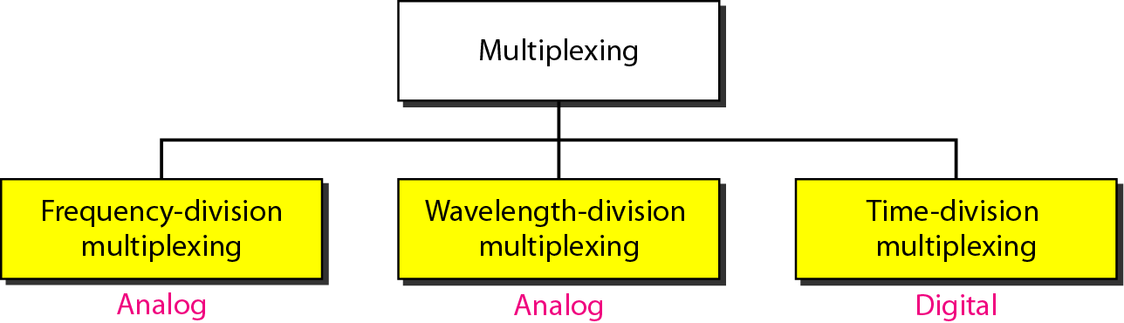
Types of Analog and Digital multiplexing.

Slide 7
Advantages of Multiplexing.
More than one signal can be sent over a single medium.
The bandwidth of a medium can be utilized effectively.

Slide 8
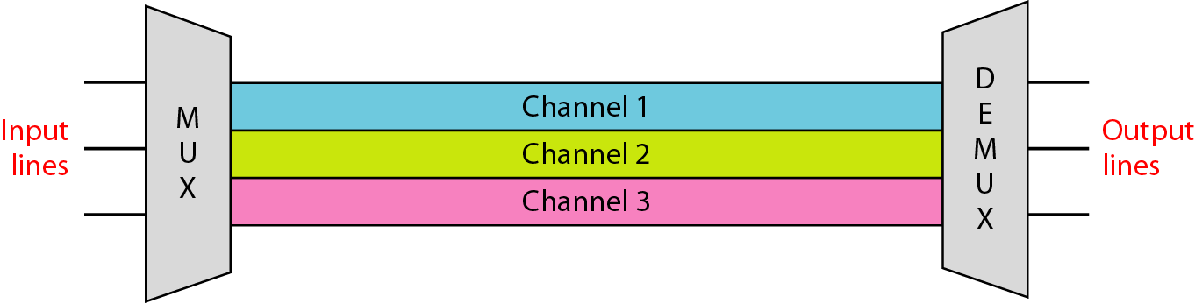
What is Frequency-division multiplexing (FDM) ?
It is a type of technique which is based on sharing bandwidth of a common communication channel.
The main aim of the FDM is to subdivide the available bandwidth into different frequency channels and allocate them to different devices.
It is an analog technique. It is mainly used in radio broadcasts and TV networks.

Slide 9
What are Advantages Of FDM ?
FDM is used for analog signals.
FDM process is very simple and easy modulation.
A Large number of signals can be sent through an FDM simultaneously.
It does not require any synchronization between sender and receiver.

Slide 10
Disadvantages of FDM.
FDM technique is used only when low-speed channels are required.
It suffers the problem of crosstalk.
A Large number of modulators are required.
It requires a high bandwidth channel.

Slide 11
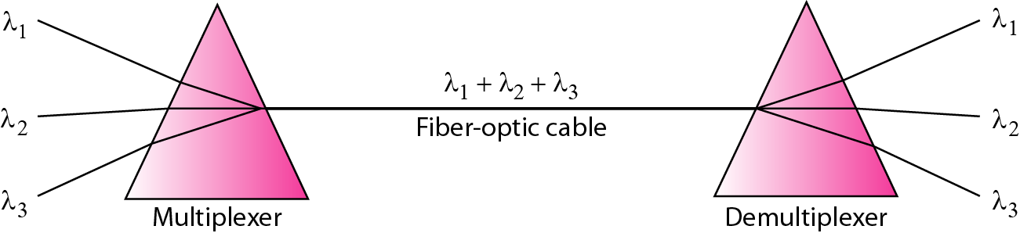
What is Wavelength- division multiplexing ?
WDM is an analog multiplexing technique to combine optical signals.
It is a type of multiplexing which is used to increase the capacity of optical fiber by transmitting multiple optical signals simultaneously over a single optical fiber, each with a different wavelength.
Wavelength Division Multiplexing (WDM) is a multiplexing technology used to increase the capacity of optical fiber by transmitting multiple optical signals simultaneously over a single optical fiber, each with a different wavelength

Slide 12
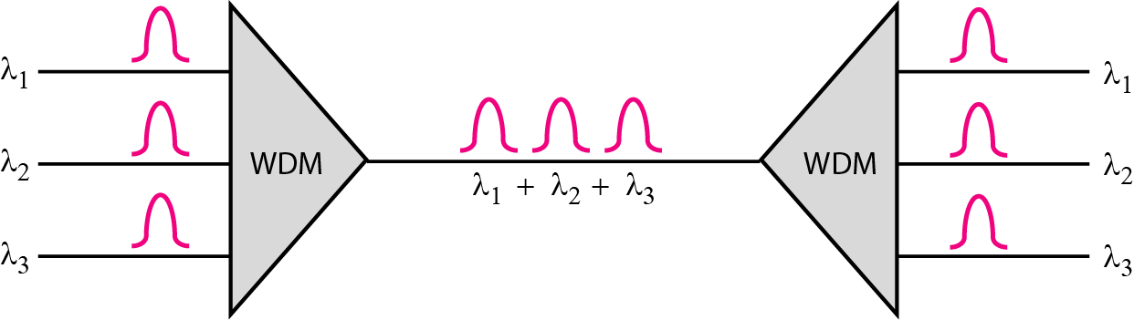
Wavelength division multiplexing .

Slide 13
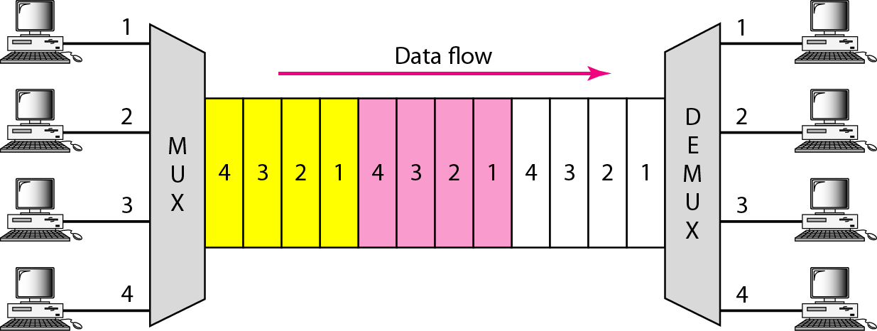
What is Time division Multiplexing ?
Time-division multiplexing is defined as a type of multiplexing wherein FDM, instead of sharing a portion of the bandwidth in the form of channels, in TDM, time is shared. Each connection occupies a portion of time in the link.
In Time Division Multiplexing, all signals operate with the same frequency (bandwidth) at different times.

Slide 14
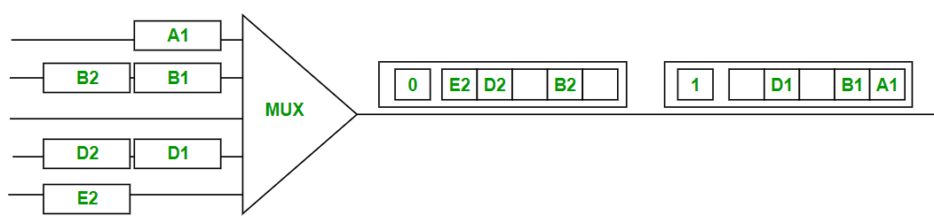
There are two types of Time Division Multiplexing -
Synchronous Time Division Multiplexing .
Statistical (or Asynchronous) Time Division Multiplexing .
Synchronous TDM : Synchronous TDM is a type of Time Division Multiplexing where the input frame already has a slot in the output frame. Time slots are grouped into frames. One frame consists of one cycle of time slots.

Slide 15
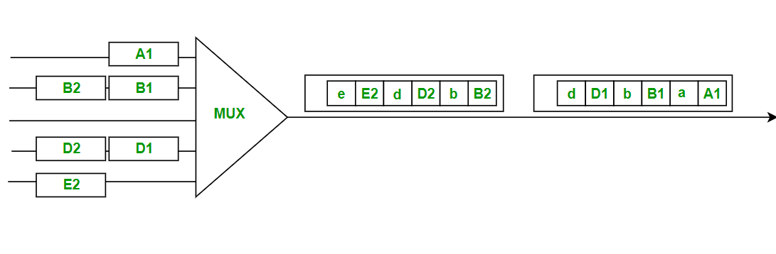
Statistical TDM .
Statistical TDM is a type of Time Division Multiplexing where the output frame collects data from the input frame till it is full, not leaving an empty slot like in Synchronous TDM.
In statistical TDM, we need to include the address of each particular data in the slot that is being sent to the output frame.

Slide 16


